Slide 1
MULTIPLE CUT REBAR
Advisor : Prof. K.C.Chang
Presenters : You-Ran Nai

Slide 2
OUTLINE
1
2
3
4
COST ANALYSIS
ROADMAP
LINEAR MULTI-CUT
PAPER-MPA

Slide 3
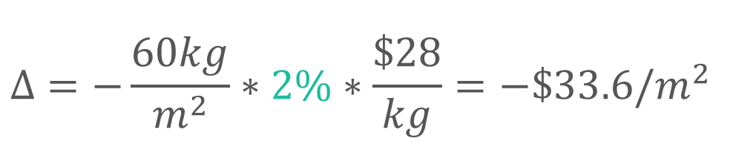
COST ANALYSIS
REDUCED PERCENTAGE
MATERIAL REDUCED COST
$$Δ=−\frac{60kg}{m^{2}}∗2\%∗\frac{\$28}{kg}=−\$33.6/m^{2}$$
GIRDER USED
MATERIAL COST

Slide 4
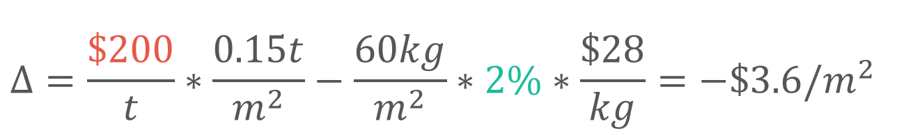
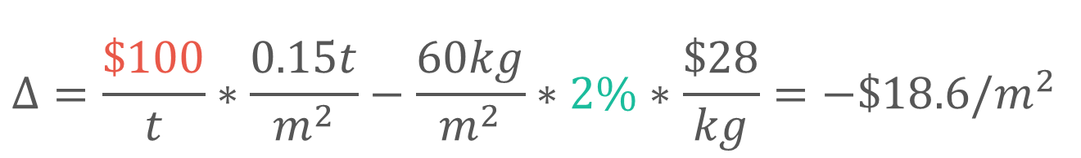
COST ANALYSIS
INCREASE
CONSTRUCTION COST
REDUCED
MATERIAL COST
$$Δ=\frac{\$100}{t}∗\frac{0.15t}{m^{2}}−\frac{60kg}{m^{2}}∗2\%∗\frac{\$28}{kg}=−\$18.6/m^{2}$$
$$Δ=\frac{\$200}{t}∗\frac{0.15t}{m^{2}}−\frac{60kg}{m^{2}}∗2\%∗\frac{\$28}{kg}=−\$3.6/m^{2}$$
INCREASE WAGE

Slide 5
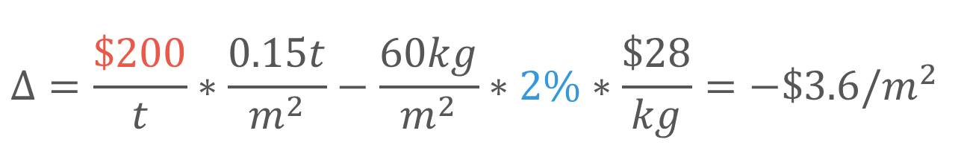
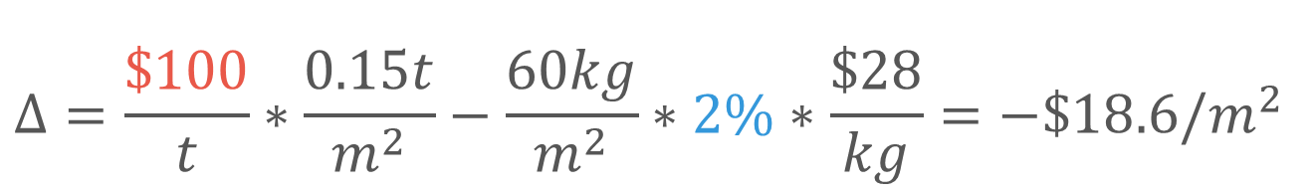
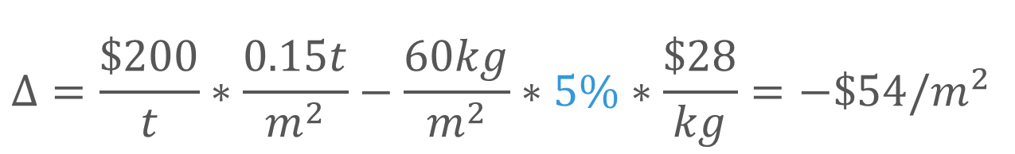

COST ANALYSIS
$$Δ=−\frac{60kg}{m^{2}}∗2\%∗\frac{\$28}{kg}=−\$33.6/m^{2}$$
$$Δ=\frac{\$100}{t}∗\frac{0.15t}{m^{2}}−\frac{60kg}{m^{2}}∗2\%∗\frac{\$28}{kg}=−\$18.6/m^{2}$$
$$Δ=\frac{\$200}{t}∗\frac{0.15t}{m^{2}}−\frac{60kg}{m^{2}}∗2\%∗\frac{\$28}{kg}=−\$3.6/m^{2}$$
$$Δ=\frac{\$200}{t}∗\frac{0.15t}{m^{2}}−\frac{60kg}{m^{2}}∗5\%∗\frac{\$28}{kg}=−\$54/m^{2}$$

Slide 6
LINEAR
NON-LINEAR
2
3
RIGOROUS
PROCEDURE
ETABS9
PYTHON
ETABS2016/SAP
MATLAB
IDA
ETABS DEMAND
MULTI-CUT
NONLINEAR HISTORY ANALYSIS
1
4
ENGINEERING
SIMPLICITY
EXCEL
VBA
ETABS9
PYTHON
MPA
MMC
APA
FROM EXISTING REBAR
MULTI-MODES PUSHOVER

Slide 7
3
Incremental dynamic analysis
RIGOROUS
PROCEDURE
NONLINEAR HISTORY ANALYSIS
Incremental dynamic analysis with multi-modes for seismic performance evaluation of RC bridges
4
ENGINEERING
SIMPLICITY
A modal pushover analysis procedure for estimating seismic demands for buildings
MULTI-MODES PUSHOVER
A modal pushover analysis procedure to estimate seismic demands for unsymmetric-plan buildings

Slide 8
Incremental dynamic analysis
Incremental dynamic analysis with multi-modes for seismic performance evaluation of RC bridges
A modal pushover analysis procedure for estimating seismic demands for buildings
A modal pushover analysis procedure to estimate seismic demands for unsymmetric-plan buildings

Slide 9
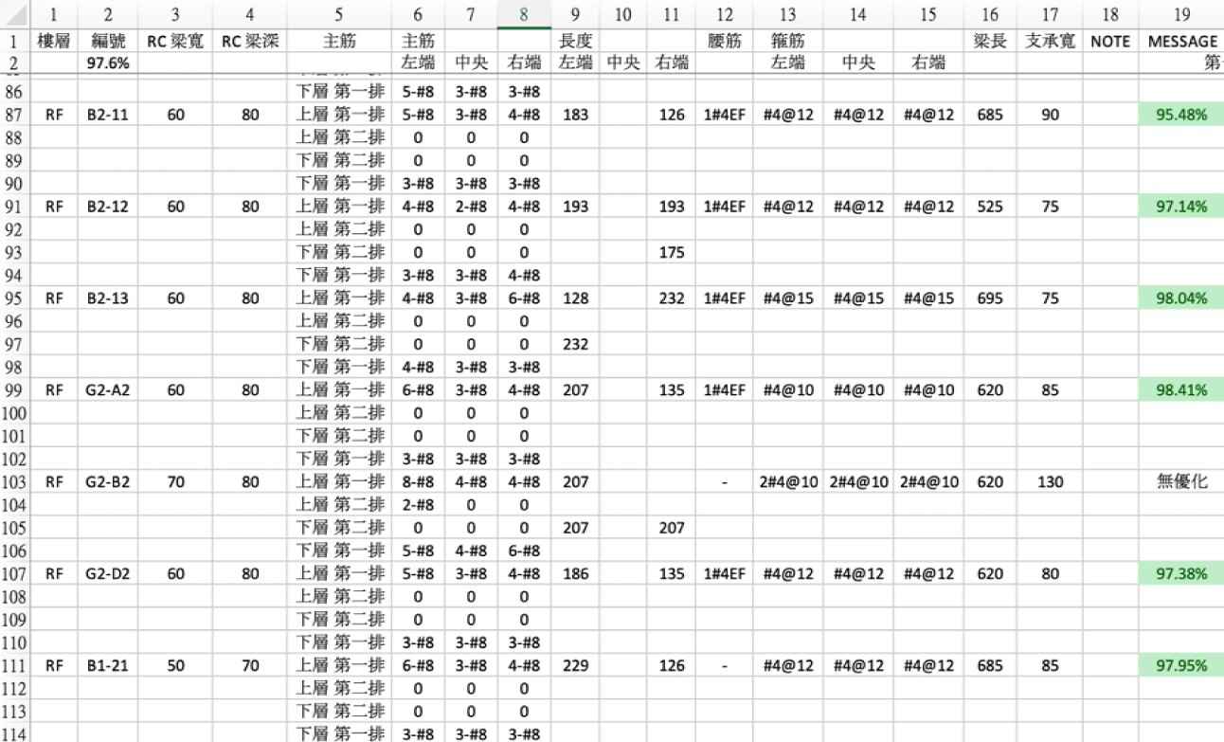
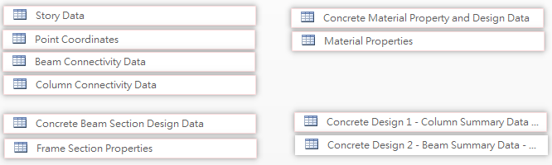
SOFTWARE ARCHITECTURE
INPUT
CONTROLLER
OUTPUT
GEOMETRY
MATERIAL
SECTION
DESIGN REBAR
SIZE
NUMBER
DEVELOPMENT LENGTH
- EXCEL

Slide 10
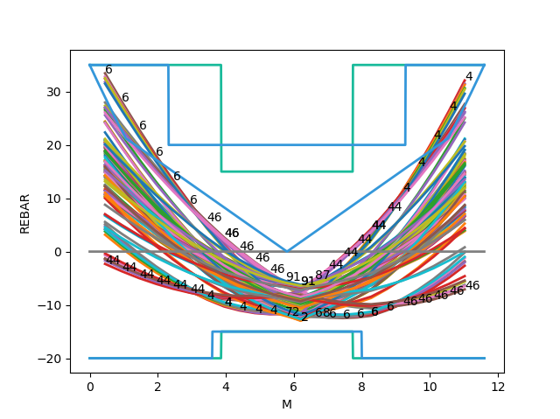
CASE STUDY
NO CONSERVATIVE
TOO MUCH REBAR

Slide 11
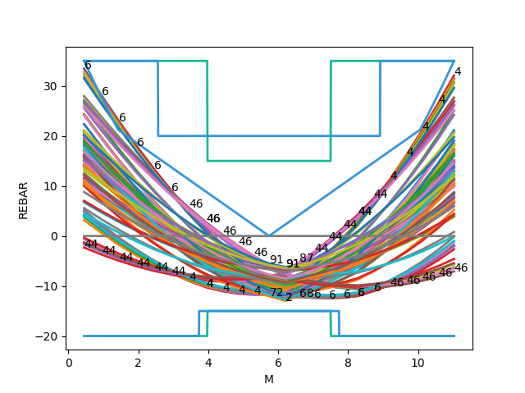
CASE STUDY
NO CONSERVATIVE
TOO MUCH REBAR
REDUCED SUPPORT WIDTH

Slide 12
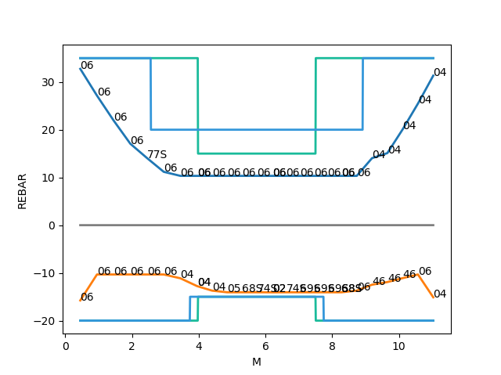
CASE STUDY
NO CONSERVATIVE
TOO MUCH REBAR
CRITERIA LIMIT

Slide 13
A modal pushover analysis procedure for estimating seismic demands for buildings
Anil K. Chopra and Rakesh K. Goel
EARTHQUAKE ENGINEERING AND STRUCTURAL DYNAMICS
August 2001

Slide 14
INTRODUCTION
NON-LINEAR RESPONSE HISTORY ANALYSIS (RHA)
RIGOROUS PROCEDURE
INELASTIC BEHAVIOUR
PUSHOVER ANALYSIS
LOW- AND MEDIUM-RISE STRUCTURES
ADAPTIVE FORCE DISTRIBUTIONS (APA)
TIME-VARIANT DISTRIBUTIONS
MODAL PUSHOVER ANALYSIS

Slide 15
ELASTIC BUILDINGS
MODAL RESPONSE HISTORY ANALYSIS
MODAL RESPONSE SPECTRUM ANALYSIS
MODAL PUSHOVER ANALYSIS

Slide 16







MODAL RHA
DIFFERENTIAL EQUATION
MODAL COORDINATE
n-th MODE RESPONSE
COMBINE ALL MODES

Slide 17
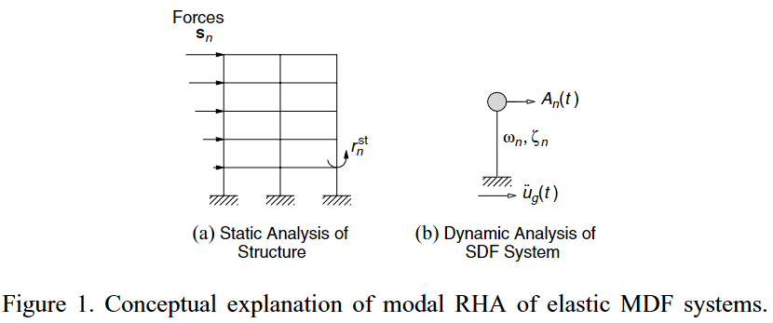


MODAL RSA and
MPA
RESPONSE (OR DESIGN) SPECTRUM
SRSS CQC

Slide 18
INELASTIC BUILDINGS
RESPONSE HISTORY ANALYSIS
UNCOUPLED MODAL RESPONSE HISTORY ANALYSIS
MODAL PUSHOVER ANALYSIS

Slide 19


RHA
DEPEND ON THE HISTORY OF THE DISPLACEMENTS
COUPLE

Slide 20
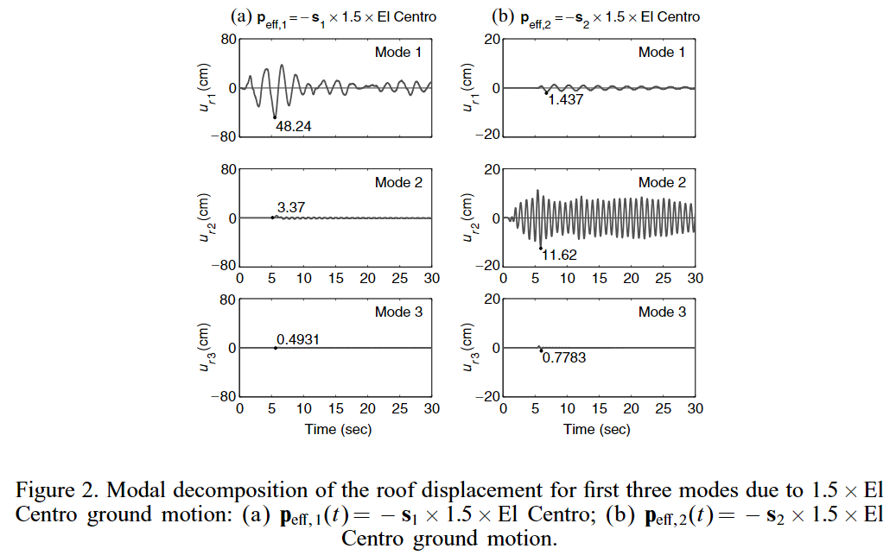

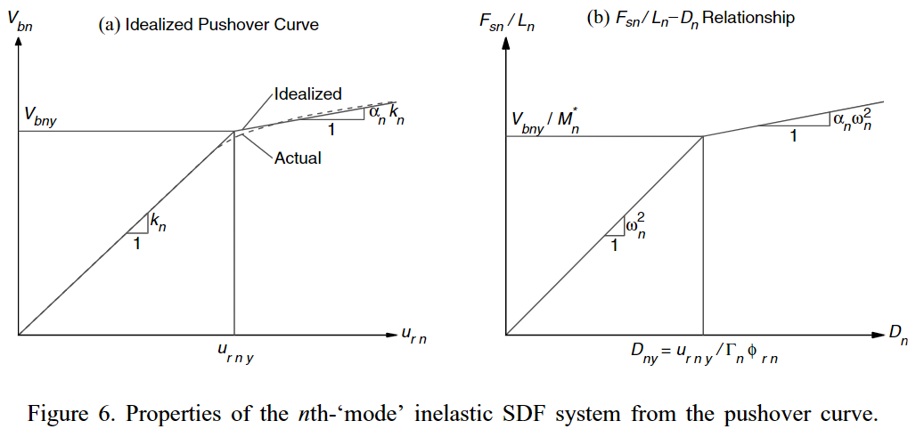
UMRHA
MODAL COORDINATE
APPROXIMATION
A Modal Pushover Analysis Procedure to Estimate Seismic Demands for Buildings: Theory and Preliminary Evaluation

Slide 21
UMRHA
MODAL COORDINATE
APPROXIMATION
n-th MODE RESPONSE
COMBINE ALL MODES

Slide 22
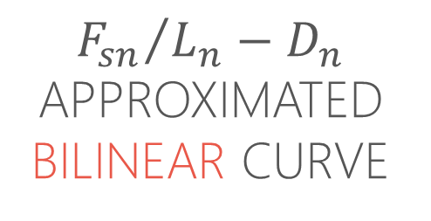
ERRORS ARISE
ASSUMPTIONS AND APPROXIMATIONS
NEGLECT YIELDING COUPLE
SUPERPOSITION OF RESPONSES VALID LINEARLY ELASTIC
$${F_{sn}}/{L_{n}−D_{n}}$$
APPROXIMATED BILINEAR CURVE

Slide 23
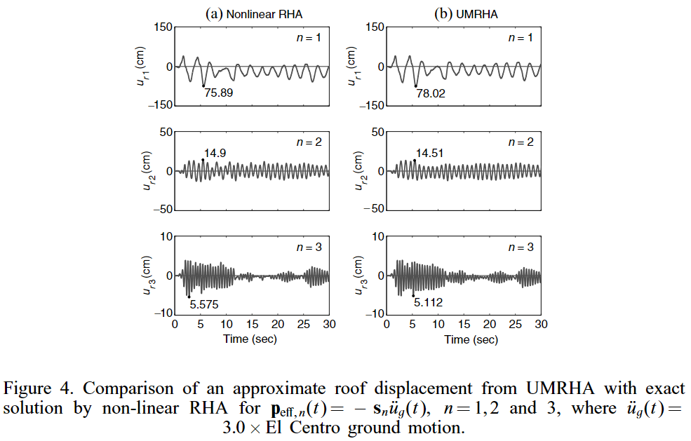
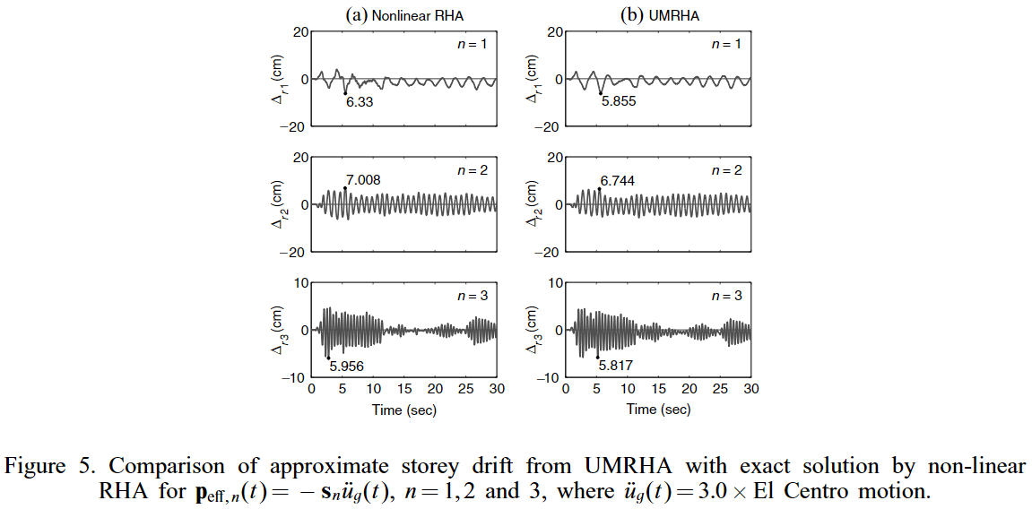
COMPARE WITH RHA

Slide 24
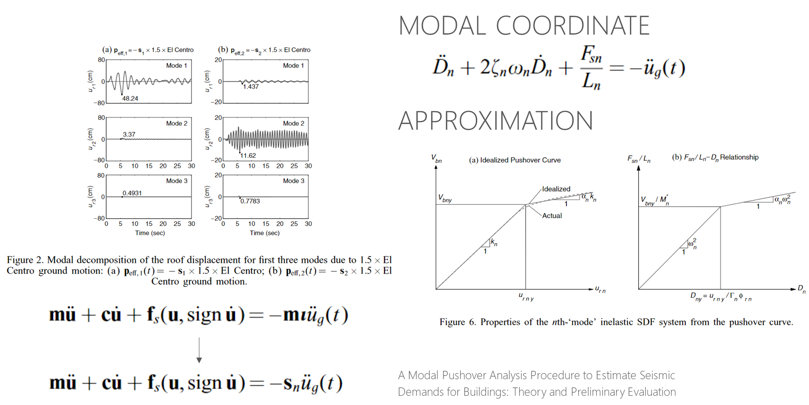
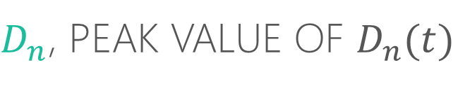
MPA
$D_{n}$, PEAK VALUE OF $D_{n}(t)$
RESPONSE (OR DESIGN) SPECTRUM
SRSS CQC

Slide 25
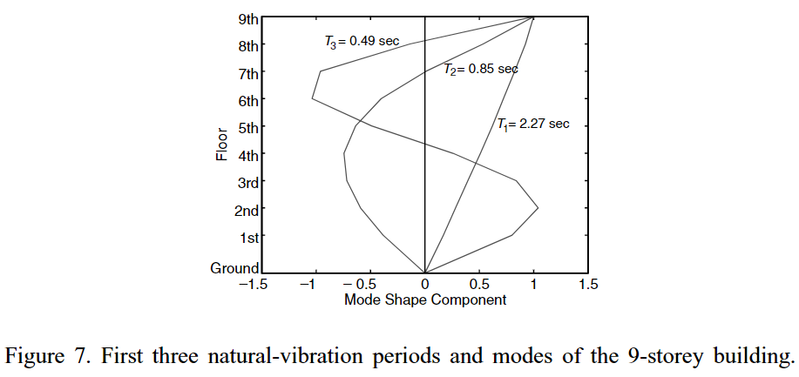
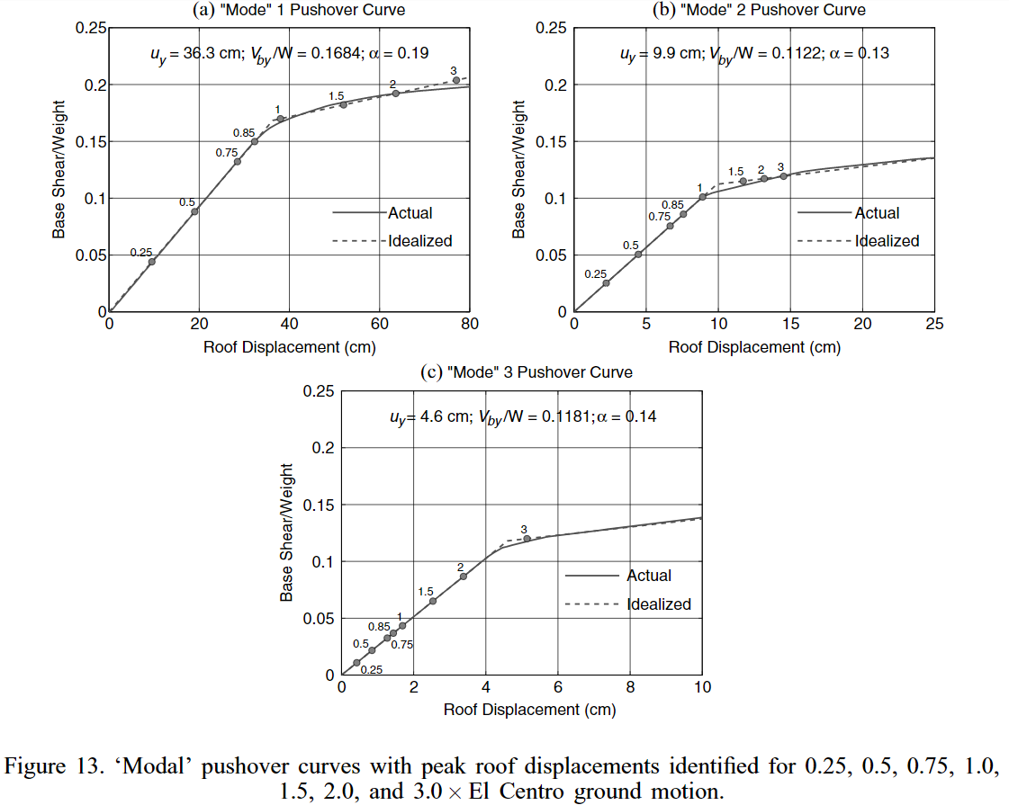
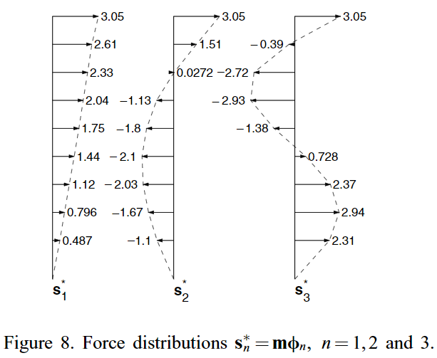

Slide 26
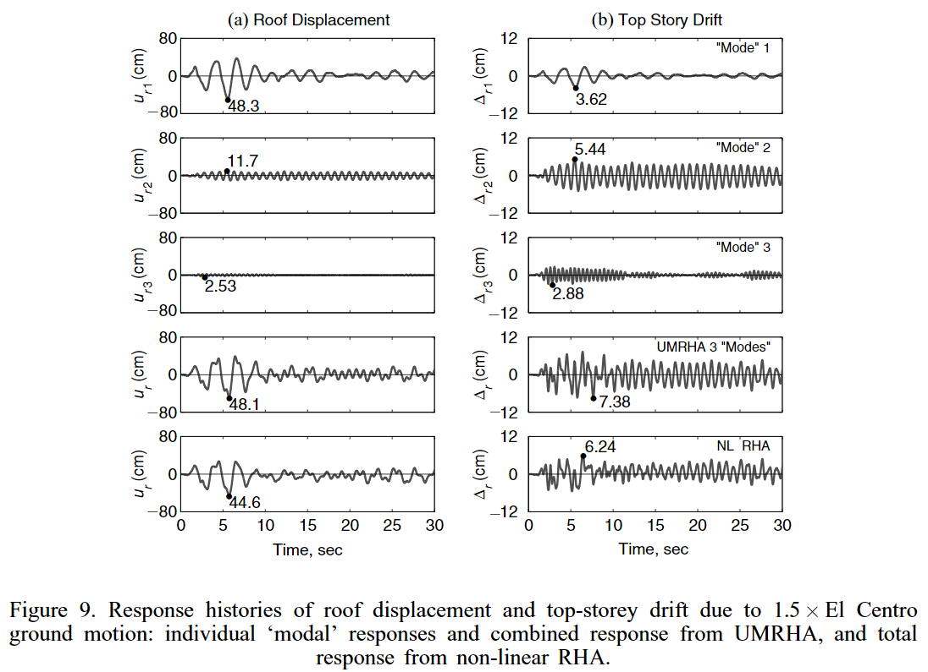
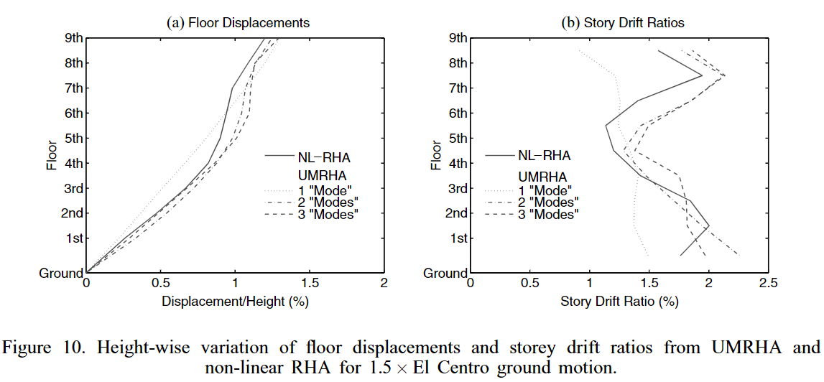
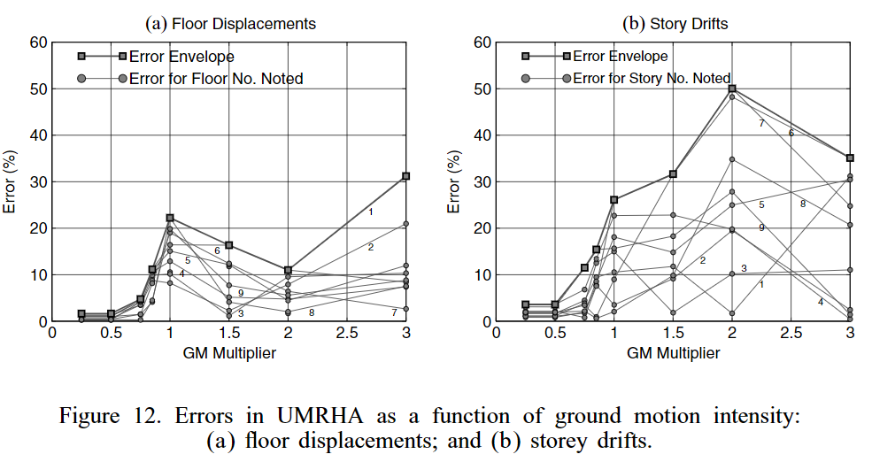
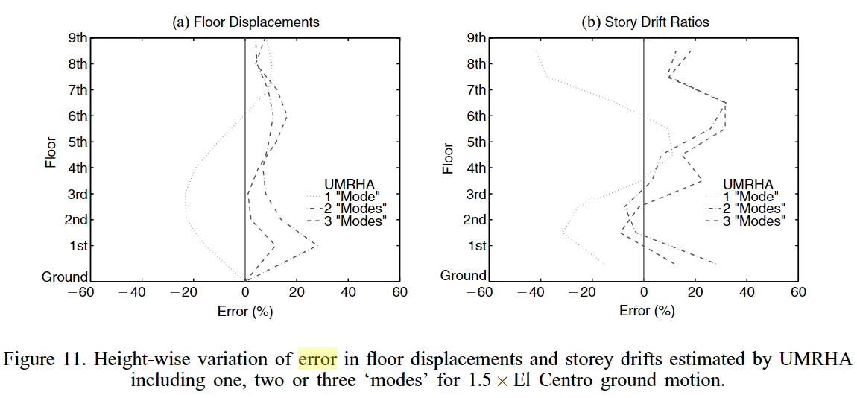

Slide 27
Notes:
the errors
are small (less than 5 per cent) for ground motion multipliers up to 0.75;
increase rapidly as the ground motion multiplier increases to 1.0;
maintain roughly similar values for more intense ground motions; and
are larger in storey drifts compared to floor displacements.
UMRHA lacks a rigorous theory and is based on several approximations.
bilinear curve

Slide 28
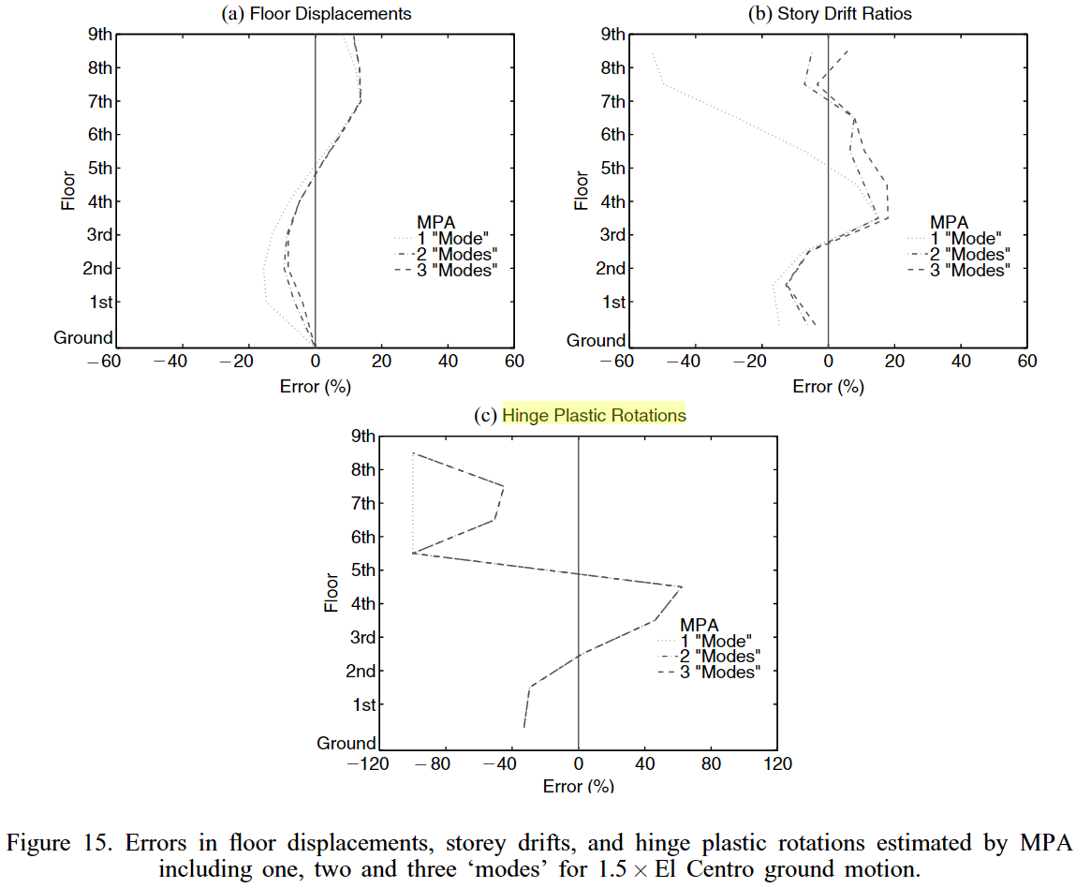
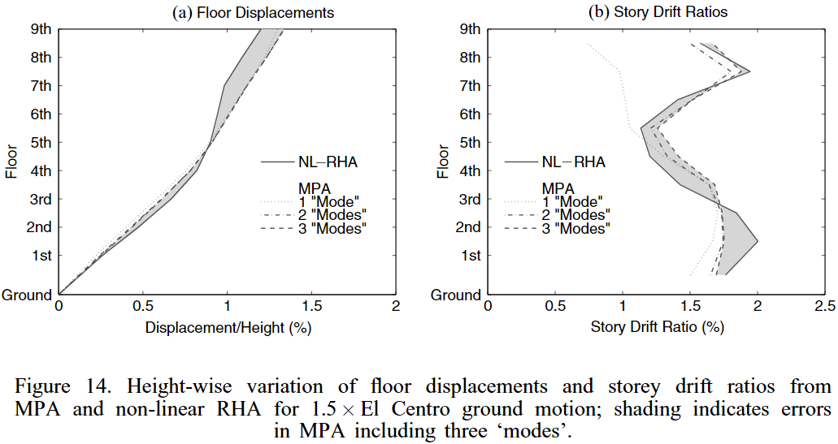
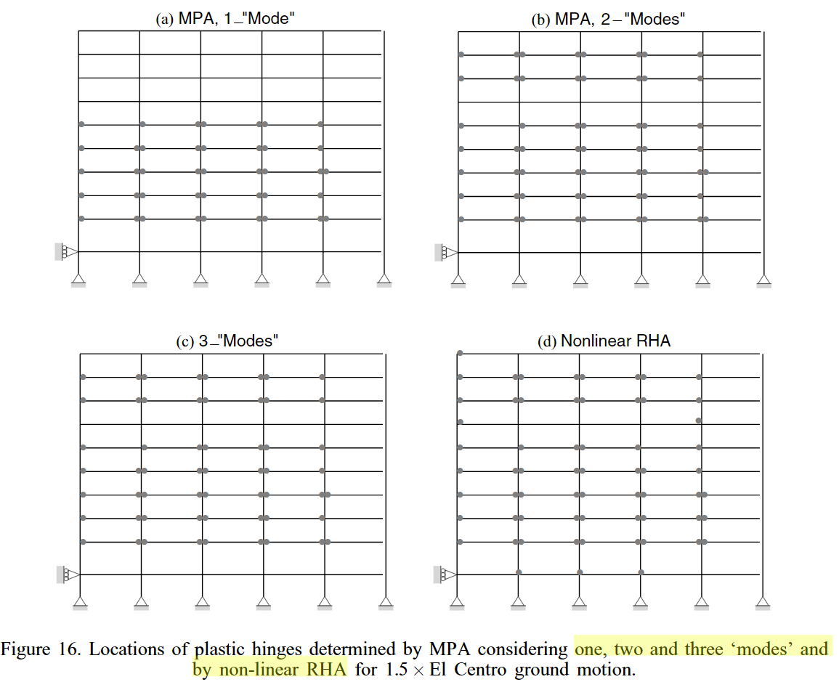
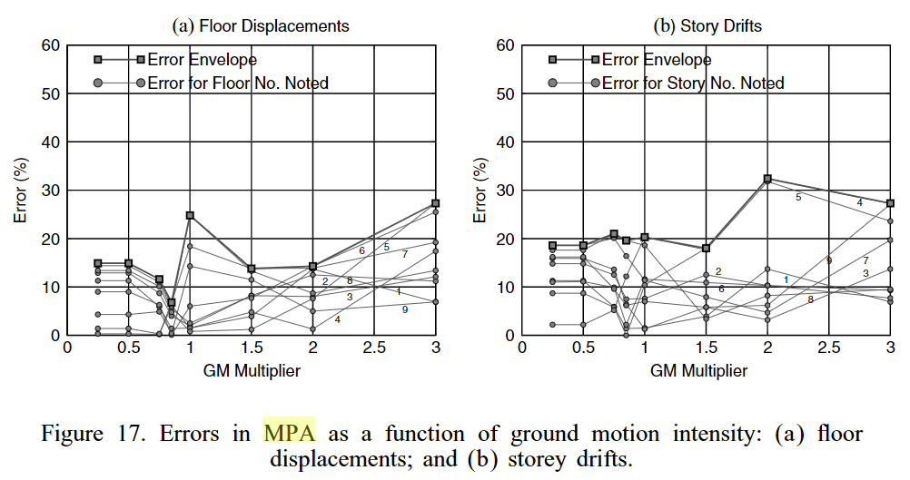

Slide 29
COMPARATIVE
UMRHA
MPA
Notes:
Error inherent
MPA small
UMRHA < 0.75 exact MPA SRSS CQC error

Slide 30
MPA CONSLUSIONS
EQUIVALENT RSA
ASSUMPTIONS
NOTE ERRORS
STANDARD RSA =>
MODAL PUSHOVER ANALYSIS
UNCOUPLE
BILINEAR CURVE
SRSS
PLASTIC HINGE
SMALL ERROR IN
FLOOR DISPLACEMENTS

Slide 31
LINEAR
NON-LINEAR
2
3
RIGOROUS
PROCEDURE
ETABS9
PYTHON
ETABS2016/SAP
MATLAB
IDA
ETABS DEMAND
MULTI-CUT
NONLINEAR HISTORY ANALYSIS
1
4
ENGINEERING
SIMPLICITY
EXCEL
VBA
ETABS9
PYTHON
MPA
MMC
APA
FROM EXISTING REBAR
MULTI-MODES PUSHOVER

